Slide 1
FINAL CAPSTONE PROJECT – BATTLE OF THE NEIGHBORHOOD
HELP GUIDE MOVING TO SCARABOUGH TORONTO

Slide 2
INTRODUCTION
Many people are often migrating because of work placements. So people need to know some clear living location where every aspect of primary needs is in reach. Children needs also need to be look at so school information also important.
This Project aim to create an analysis of features for a people migrating to Scarborough to search a best neighborhood as a comparative analysis between neighborhoods. The features include median housing price and better school according to ratings, crime rates of that particular area, road connectivity, weather conditions, good management for emergency, water resources both freash and waste water and excrement conveyed in sewers and recreational facilities.
Hopefully this will help people who are planning on moving to Toronto.

Slide 3
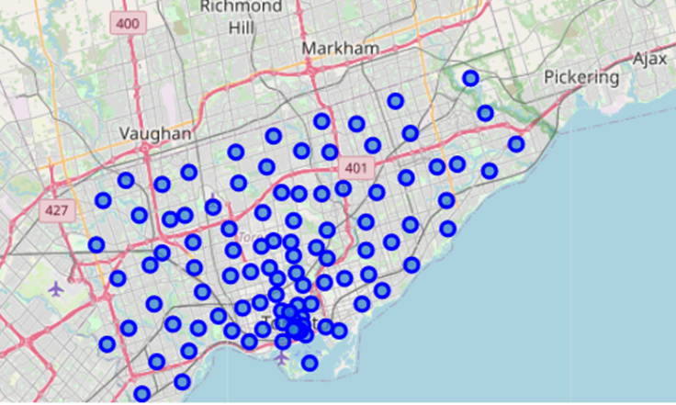
DATA ACQUISITION
Data Link: https://en.wikipedia.org/wiki/List_of_postal_codes_of_Canada:_M
Used for Scarborough dataset which we scrapped from Wikipedia.
Foursquare API Data:
Foursquare data to provide nearby venues or public areas.
The information obtained per venue as follows:
Neighborhood
Neighborhood Latitude
Neighborhood Longitude
Venue
Name of the venue e.g. the name of a store or restaurant
Venue Latitude
Venue Longitude
Venue Category

Slide 4
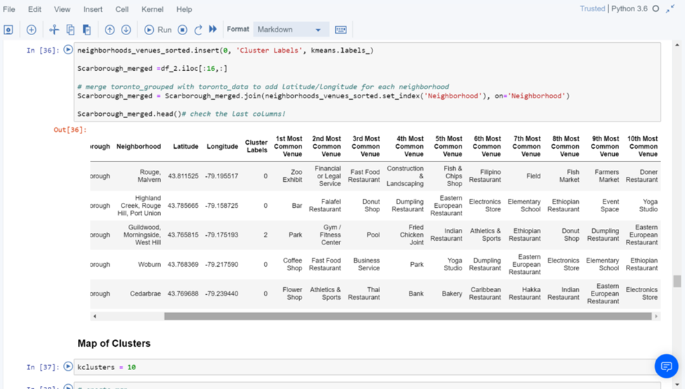
METHODOLOGY
Clustering Approach:
To compare the similarities of two cities, we decided to explore neighborhoods, segment them, and group them into clusters to find similar neighborhoods in a big city like New York and Toronto. To be able to do that, we need to cluster data which is a form of unsupervised machine learning: k-means clustering algorithm.

Slide 5
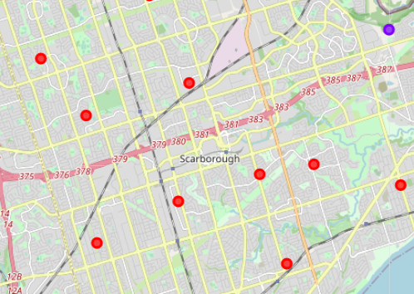
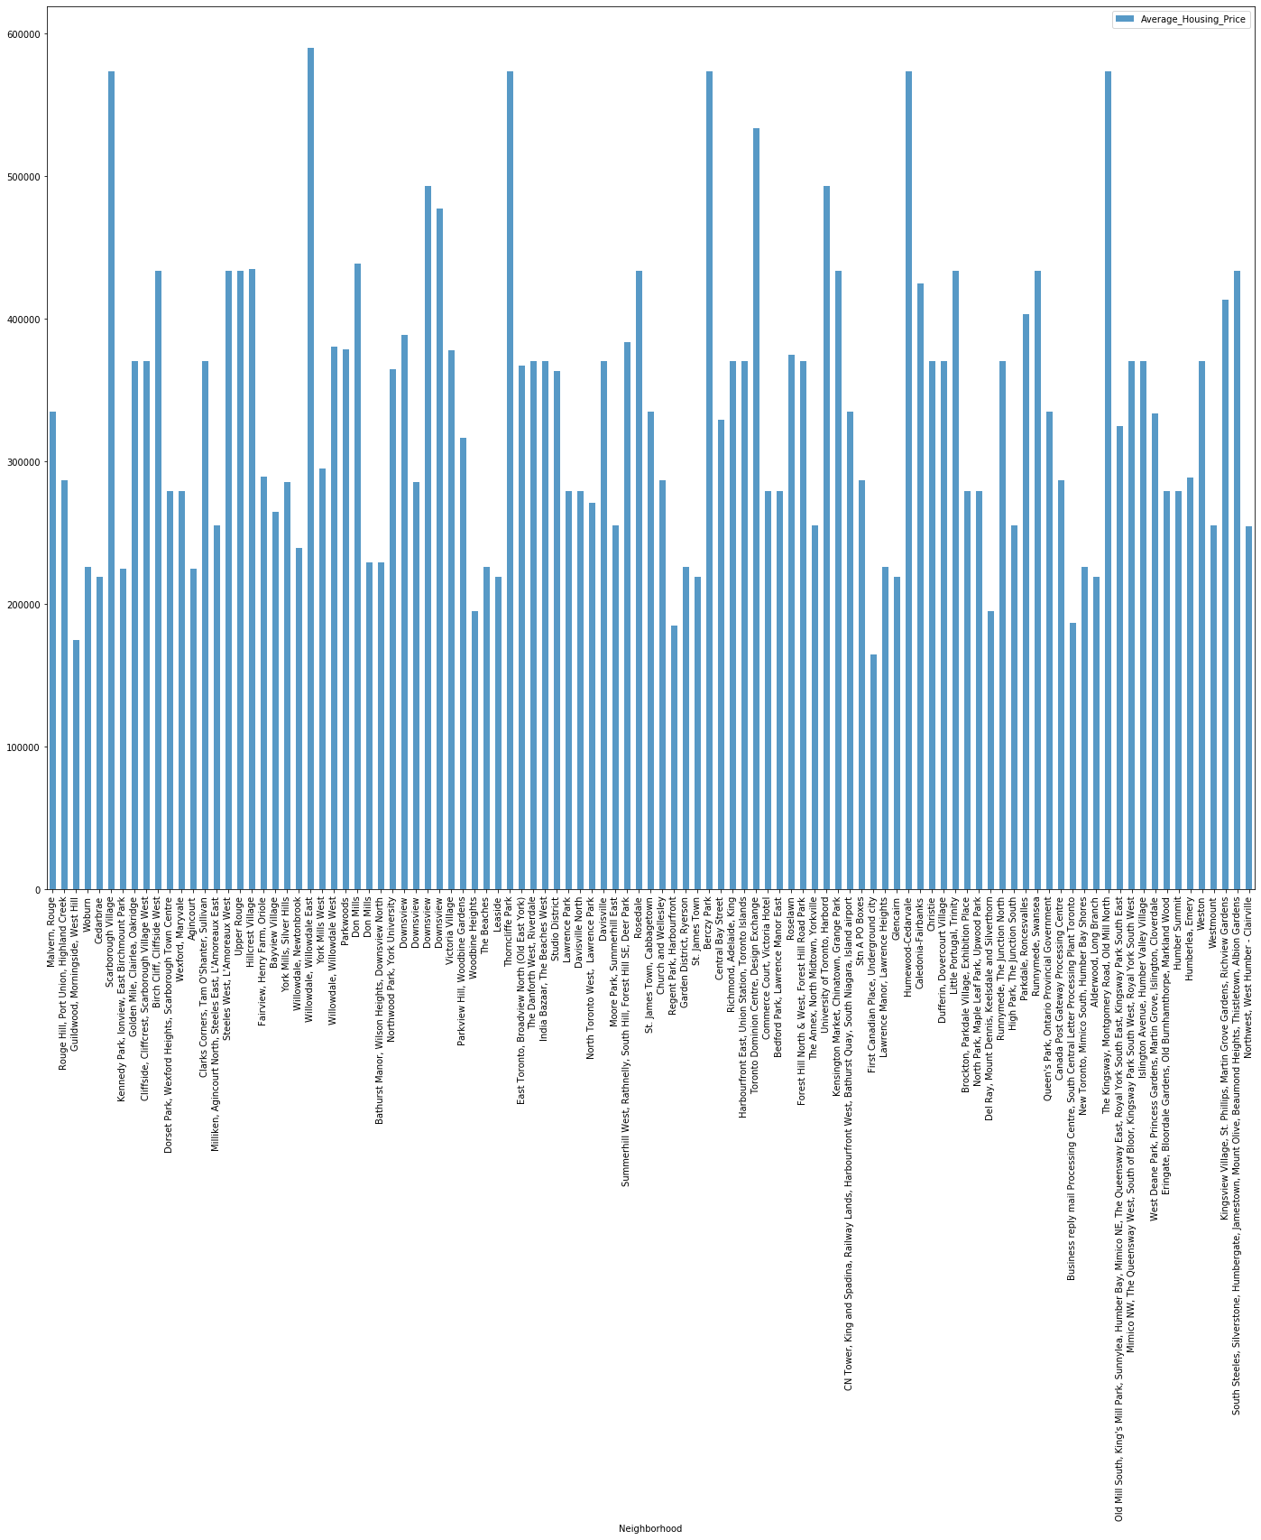
RESULT
Map of Clusters in Scarborough
Scaborough Average Housing Price

Slide 6
DISCUSSION
Problem Which Tried to Solve:
The major purpose of this project, is to suggest a better neighborhood in a new city for the person who are shiffting there. Social presence in society in terms of like minded people. Connectivity to the airport, bus stand, city center, markets and other daily needs things nearby.
Sorted list of house in terms of housing prices in a ascending or descending order
Sorted list of schools in terms of location, fees, rating and reviews

Slide 7
CONCLUSION
In this Capstone project, using k-means cluster algorithm I separated the neighborhood into 10(Ten) different clusters and for 103 different lattitude and logitude from dataset, which have very-similar neighborhoods around them. Using the charts above results presented to a particular neighborhood based on average house prices and school rating have been made.
I feel rewarded with the efforts and believe this course with all the topics covered is well worthy of appreciation. This project has shown me a practical application to resolve a real situation that has impacting personal and financial impact using Data Science tools. The mapping with Folium is a very powerful technique to consolidate information and make the analysis and decision better with confidence.

